Slide 1

Amazon Consumer Behavior Project Presentation
ITEC-620
Group 8: Loc Le, Briana Patel, Mohamed Seifeldin, Quynh Vo

Slide 2
Introduction
Uncover main trends in Amazon's consumer behavior
Find which independent variables impact purchase frequency the most
Goal: Derive data driven insights and actionable recommendations to help Amazon optimize marketing strategies and enhance customer experience

Slide 3
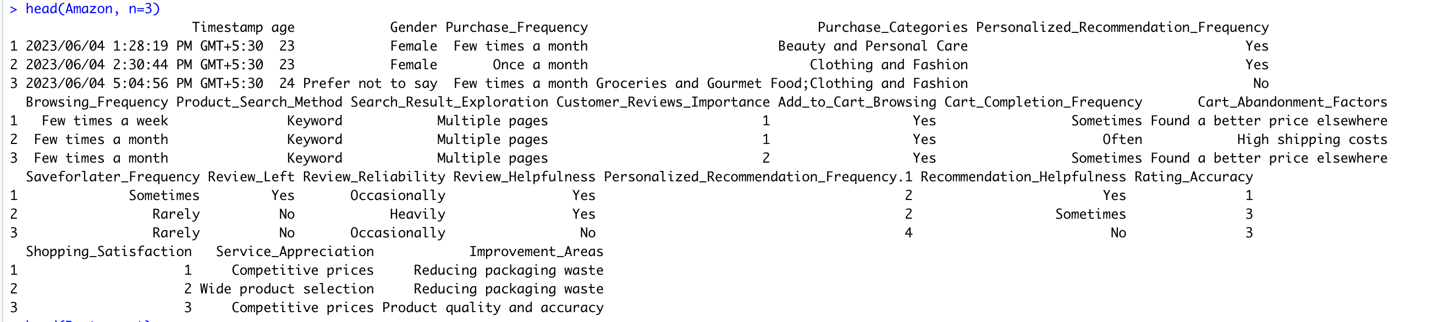
Description & Snapshot of the Dataset
Amazon consumer behavior dataset obtained from Kaggle
Number of rows: 603
Number of columns: 23
Head of dataset:

Slide 4
Description & Snapshot of Dataset
Variables:
Age​
Gender​
Purchase Frequency (Dependent Variable)​
Purchase Categories​
Personalized Recommendation Frequency​
Browsing Frequency​
Product Search Method​
Search Result Exploration​
Customer Reviews Importance​
Add to Cart Browsing​
Cart Completion Frequency​
Cart Abandonment Factors​
Save for Later Frequency​​
Review Left​​
Review Reliability​​
Review Helpfulness​​
Personalized Recommendation Frequency.1
Recommendation Helpfulness​​
Rating Accuracy​​
Shopping Satisfaction​​
Service Appreciation​​
Improvement Areas​

Slide 5
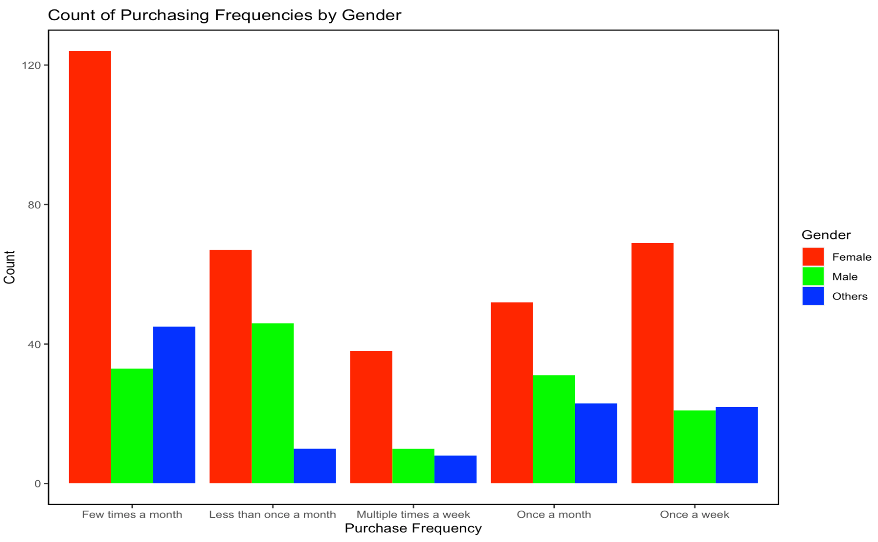
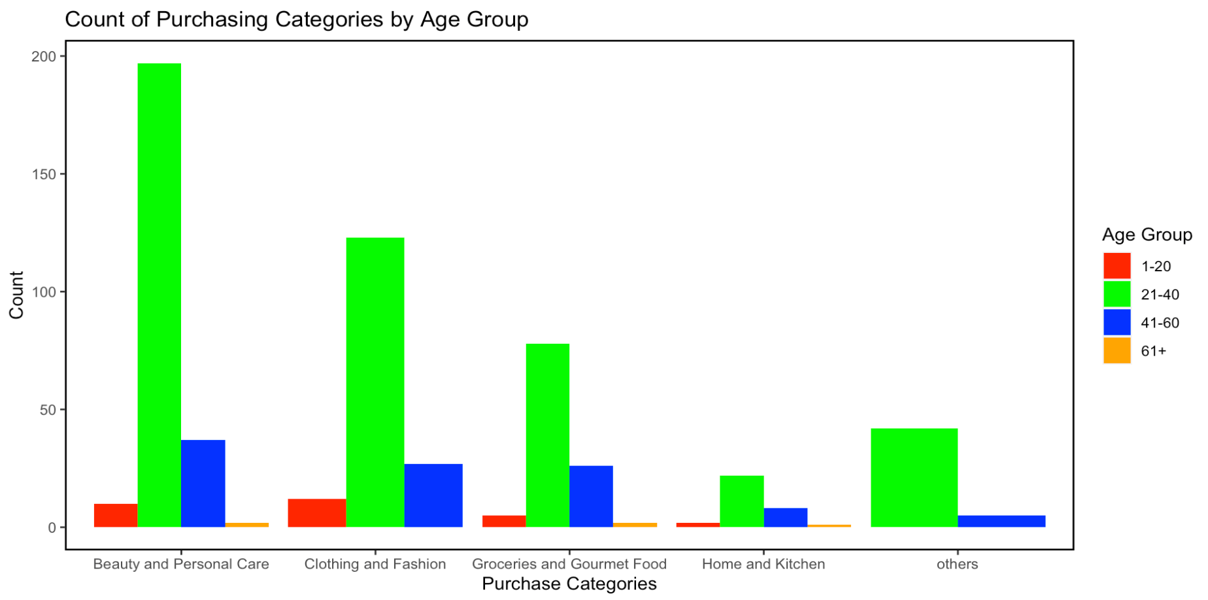
Exploratory Data Analysis
Females are the most popular gender
Most customers purchase from Amazon a few times a month
Customers between the ages of 21-40 purchase from Amazon the most
Beauty and Personal Care products are the most popular category

Slide 6
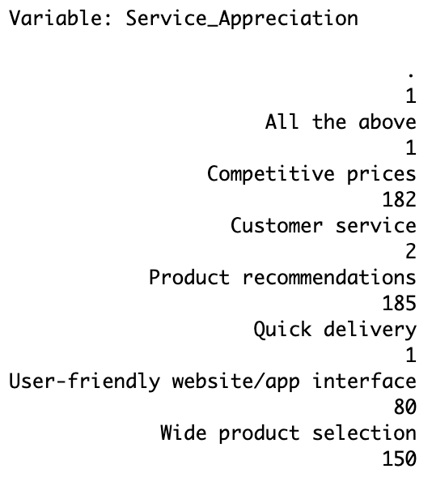
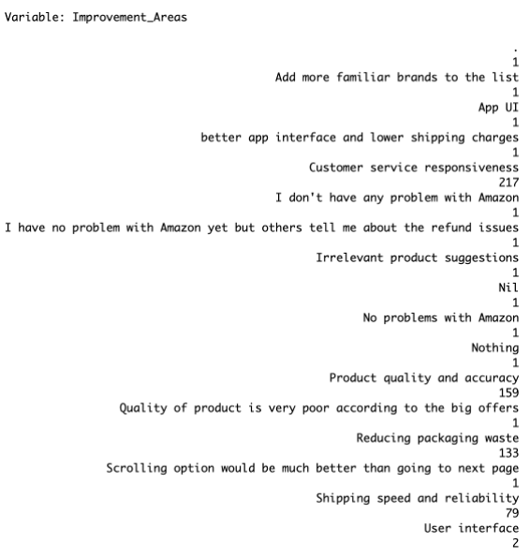
Data & Modeling Challenges
Weird values needed to be removed
Blanks, ".", N/A
Many values were inconsistent
UI & User Interface, Nil & Nothing, etc.
Some values had spaces or other special characters that would produce errors
Lots of categorical variables
Infrequently occurring values needed to be grouped into an "Others" category
Left with 67 total variables
Code sharing issues

Slide 7
Analyzation Methods (Preliminary Work)
Converted Purchase_Frequency to Purchase_Frequency_Num
Less than once a month = 0.5 purchases a month
Once a month = 1 purchase a month
Few times a month = 3 purchases a month
Once a week = 5 purchases a month
Multiple times a week = 7 purchases a month
Removed variables that would not be used in the analysis
Purchase_Frequency & old categorical variables
60/40 split of training and testing data

Slide 8
Linear Regression, KNN, & Regression Tree
 | Linear Regression | KNN | Regression Tree
Purpose: | Make predictions & find the most significant variables | Make predictions | Make predictions
Optimization: | Remove variables that were not statistically significant | Best k = 25 | Best mindev = 0.045
RMSE: | 1.97 | 1.95 | 2.04

Slide 9
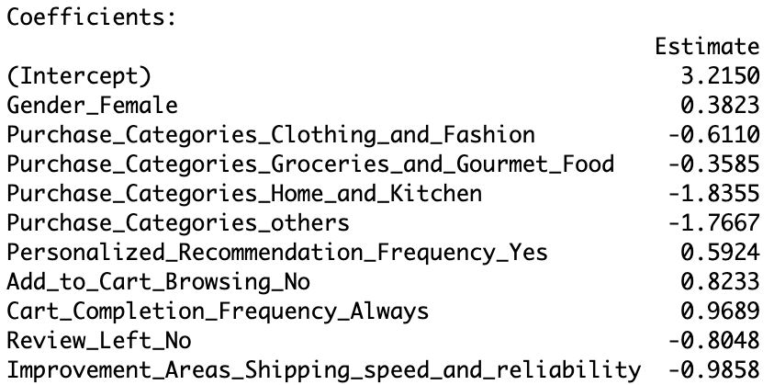
Results
KNN is the most accurate for making predictions
Most impactful variables on purchase frequency:

Slide 10
Implications for Amazon
Develop a marketing strategy that focuses on the main drivers of purchasing frequency
Based on the data some variables had a negative impact on purchases
Increase more promotions for "Cart Browsing" and "Personalized recommendations"

Slide 11

Conclusion
KNN model had the best predicative capabilities
Linear Regression showed multiple positive and negative trends on Purchases
Improving Customer experience has a positive impact on Purchases.

